Slide 1

COVID19

Slide 2
The Life of a virus
A quick review of introductory concepts

Slide 3

One Grain of Rice a mathematical Folktale by Demi

Slide 4


One virus
A single virus can initiate an infection if it finds the target cell.
For SARSCoV2, target cells are those containing “ACE2” receptors that react with the external spike proteins.
These are generally lung or gastrointestinal membrane cells.

Slide 5
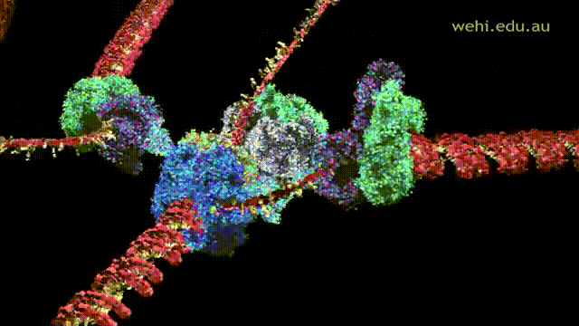
One virus
After infiltrating the cell, it tricks it into replicating its RNA and assembling many copies of the virus.
Mistakes made during this process
can lead to mutations

Slide 6
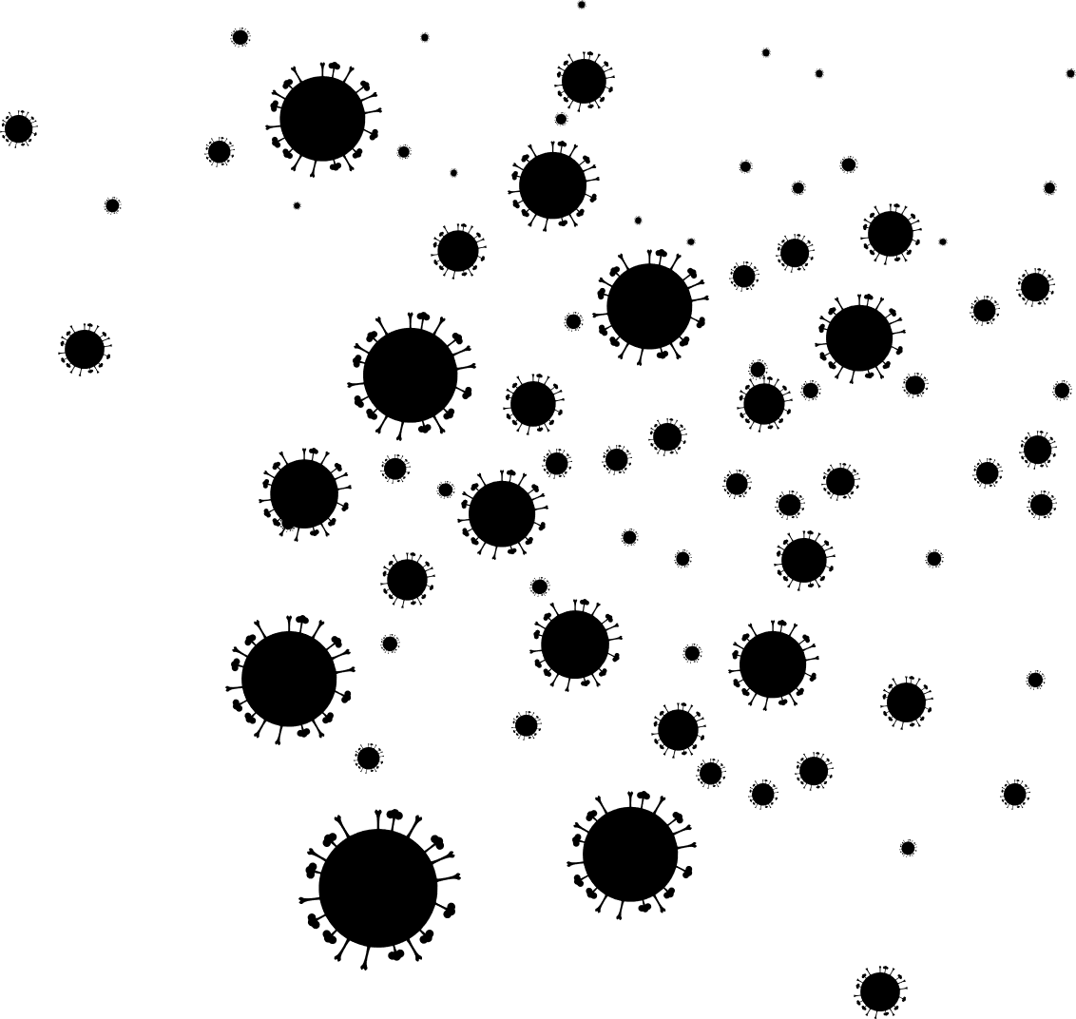
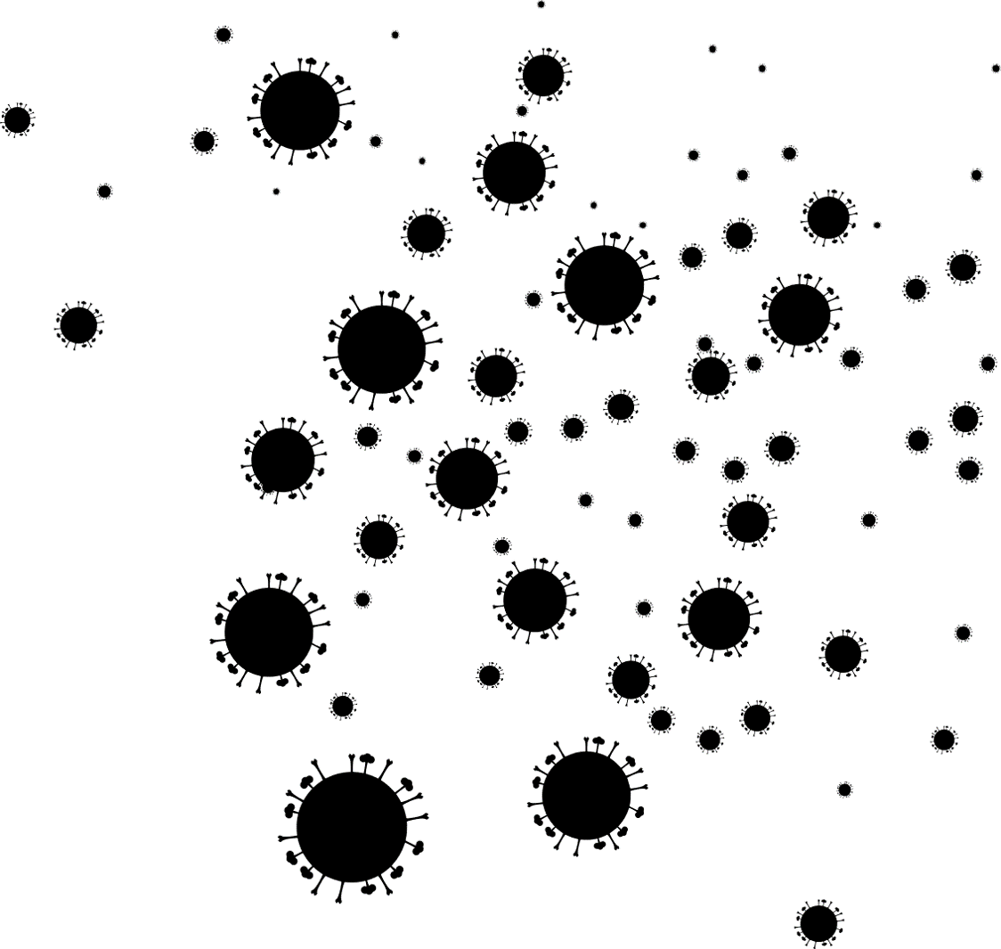
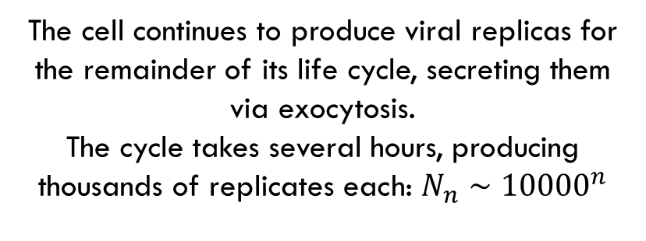
One virus
The cell continues to produce viral replicas for the remainder of its life cycle, secreting them via exocytosis.
The cycle takes several hours, producing thousands of replicates each: $N_{n}∼{10000}^{n}$

Slide 7

One virus

Slide 8
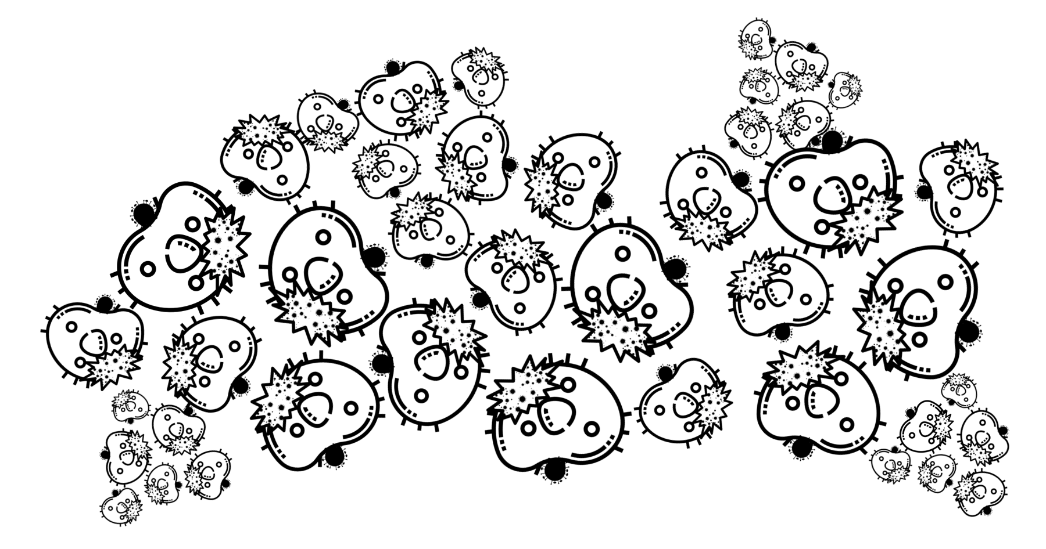

One virus

Slide 9


Slide 10

One Person
It takes between 3-14 days for symptoms to develop, dependent on a number of factors, possibly including viral load, individual immune response, blood type, infection route

Slide 11
One Person
Let’s assume that over the course of the infection, one person transmits the virus to three new people on average.
We’ll take the course of infection to be one week for simplicity
1 week

Slide 12

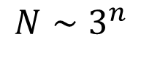
One Person
Early in the epidemic, infected grow exponentially in time!
$${N∼3}^{n}$$
1 week

Slide 13
One Person
Compare shape to real data from
Johns Hopkins
(https://github.com/CSSEGISandData/COVID-19)

Slide 14
One Person
Compare shape to real data from
Johns Hopkins
(Better to plot Logarithmically)

Slide 15
Questions
Finite number of humans on Earth!
Can’t exponentially grow indefinitely – What is late phase behavior?
What role do interventions have?
How can we understand the spread?
How do viral sequences inform our understanding of epidemics?
Can we estimate the date of patient 0?
What lies in the far future?
Why are some diseases endemic – i.e. return periodically – like the flu? Will COVID19 become endemic?

Slide 16
Modeling Epidemics
Growth, Spread, Diversity

Slide 17
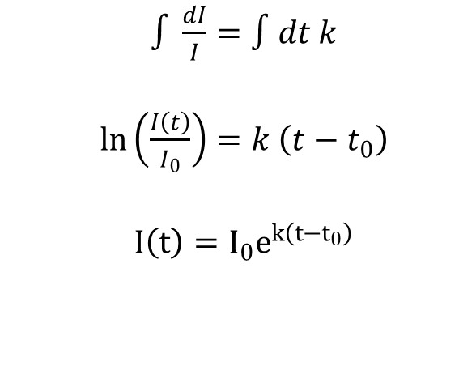
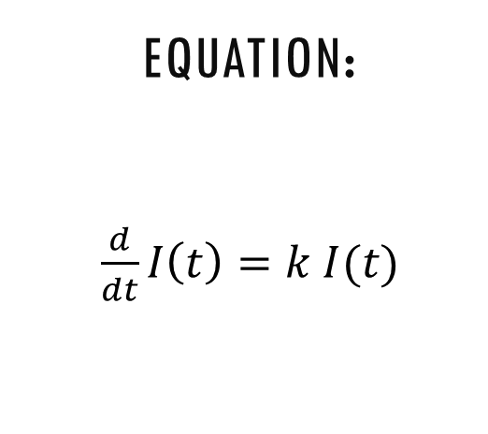
Simple Epidemiology
Starting Point: Simple exponential growth
First equation you solve in an ODE course: Change in population is proportional population size
Equation:
$\frac{d}{dt}I\left(t\right)=k I(t)$
Solution:
Plot:
$∫\frac{dI}{I}=∫dt k$
$\ln\left(\frac{I\left(t\right)}{I_{0}}\right)=k \left(t−t_{0}\right)$
$I\left(t\right)=I_{0}e^{k\left(t−t_{0}\right)}$

Slide 18
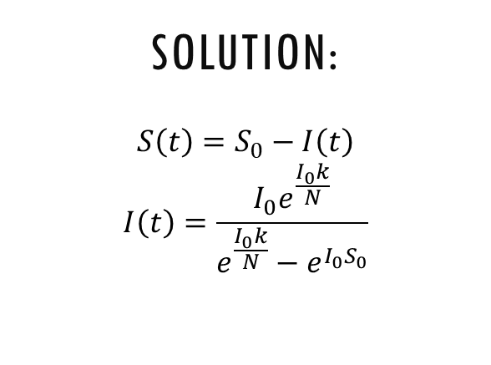
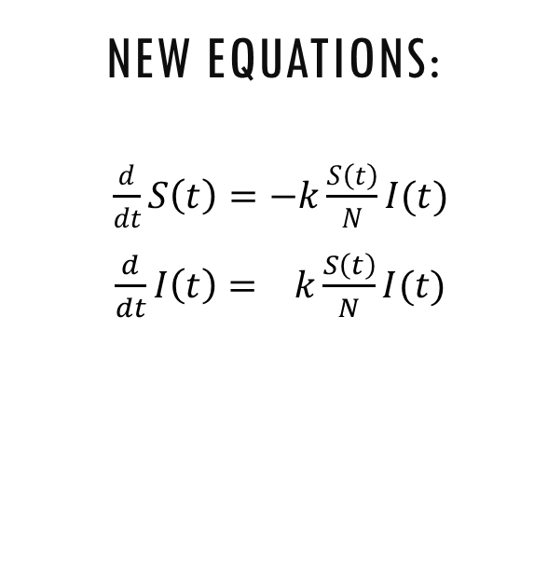
Simple Epidemiology
Correction 1: Unrealistic Numbers of New Infections!
The number of people “susceptible” to the virus monotonically decreases with infection!
Strategy:
Keep track of them with S(t)
Increase in I(t) ∝ S% and I(t)
I’ = - S’
New Equations:
$\frac{d}{dt}S\left(t\right)=−k\frac{S\left(t\right)}{N}I(t)$
$\frac{d}{dt}I\left(t\right)= k\frac{S\left(t\right)}{N}I(t)$
Solution:
$$S\left(t\right)=S_{0}−I\left(t\right)$$
$$I\left(t\right)=\frac{I_{0}e^{\frac{I_{0}k}{N}}}{e^{\frac{I_{0}k}{N}}−e^{I_{0}S_{0}}}$$

Slide 19
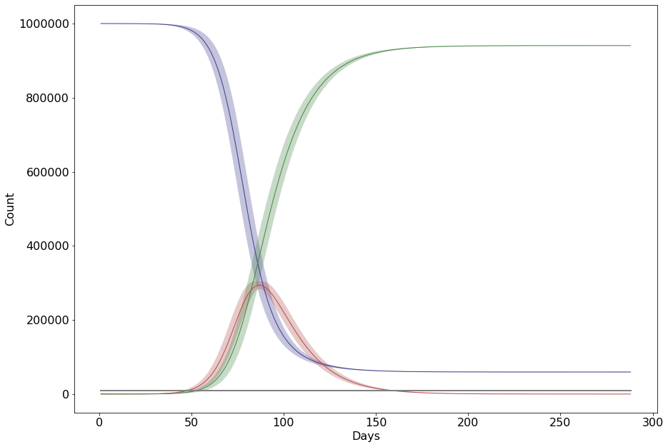
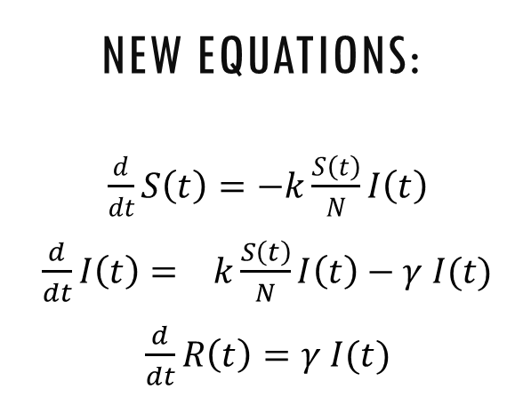
Simple Epidemiology
Correction 2: Unrealistic Numbers of Old Infections!
The number of infected decreases via recovery or death!
Strategy:
Keep track of them with R(t)
Decrease in I(t) ∝ I(t)
Increase in R(t) ∝ I(t)
New Equations:
$\frac{d}{dt}S\left(t\right)=−k\frac{S\left(t\right)}{N}I\left(t\right)$
$\frac{d}{dt}I\left(t\right)= k\frac{S\left(t\right)}{N}I\left(t\right)−γ I(t)$
$\frac{d}{dt}R\left(t\right)=γ I(t)$
Solution:
Nonlinear: No general solution!

Slide 20
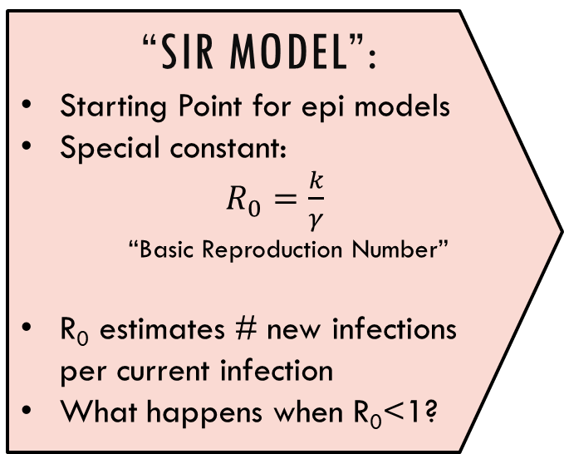
Simple Epidemiology
Correction 2: Unrealistic Numbers of Old Infections!
The number of infected decreases via recovery or death!
“SIR Model”:
Starting Point for epi models
Special constant:
$R_{0}=\frac{k}{γ}$
“Basic Reproduction Number”
R₀ estimates # new infections per current infection
What happens when R₀<1?
New Equations:
$\frac{d}{dt}S\left(t\right)=−k\frac{S\left(t\right)}{N}I\left(t\right)$
$\frac{d}{dt}I\left(t\right)= k\frac{S\left(t\right)}{N}I\left(t\right)−γ I(t)$
$\frac{d}{dt}R\left(t\right)=γ I(t)$
Solution:
Nonlinear: No general solution!

Slide 21
Simple Epidemiology
Correction N: Lots of variations!
Lots of variations to study— invent your own or visit Wikipedia “Compartmental Models in Epidemiology”
Realism:
Exposed + Age classes
Spatial diffusion
Random R₀
Seasonal Forcing
Mutant spread (*)
Mitigation:
Quarantine Measures
Contact Tracing
Vaccination
Herd immunity
Forecasting:
Resurgent Waves from Imports
Containment v.s. Endemic (*)

Slide 22
Simple Epidemiology
Important points:
The SIR model is a “Mean Field” equation: best applicable to large, dense cities
Does not capture random stochastic behaviour, or directly tell you about variance
Long term predictions are likely qualitatively wrong, especially when ignoring spatial diffusion*
*(the model has an upper critical dimension of 2 – a subtle technical point beyond the scope of undergraduate level courses!)

Slide 23
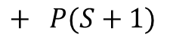
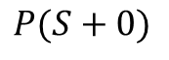
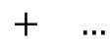
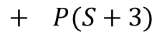
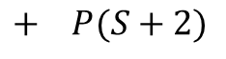
Epidemiology Cont’d
Defining a Microscopic Model: Real life is stochastic
A more realistic simulation needs to account for randomness.
$$P(S+0)$$
$$+ P(S+1)$$
$$+ P(S+2)$$
$$+ P(S+3)$$
$$+ …$$
Many outcomes with different probabilities!

Slide 24
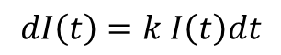
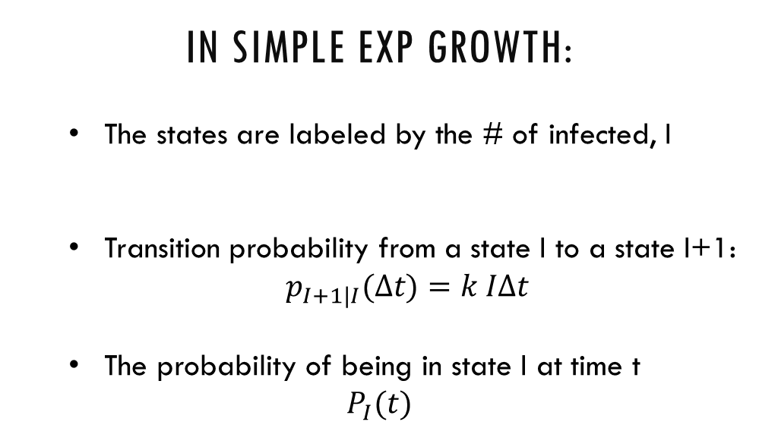
Epidemiology Cont’d
Revisit simple exponential growth Let’s learn to define a model stochastically through a master equation. Recall:
$$dI\left(t\right)=k I\left(t\right)dt$$
Components of a Stochastic Model:
A set of possible states
Probability per unit time (rate) of transitions between two given states
Probability of being in a given state
In simple Exp growth:
The states are labeled by the # of infected, I
Transition probability from a state I to a state I+1:
$p_{I+1|I}(Δt)=k IΔt$
The probability of being in state I at time t
$$P_{I}(t)$$

Slide 25
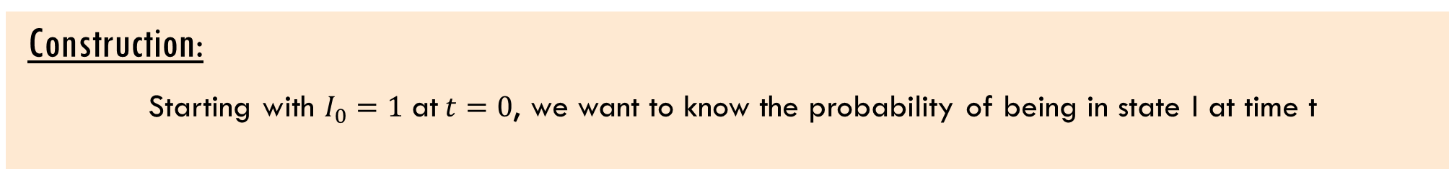
Epidemiology Cont’d
Construction:
Starting with $I_{0}=1$ at$t=0$, we want to know the probability of being in state I at time t
Markov Assumption: This can only depend on the state of the system immediately before time t
$$P_{I}\left(t\right)=?$$

Slide 26
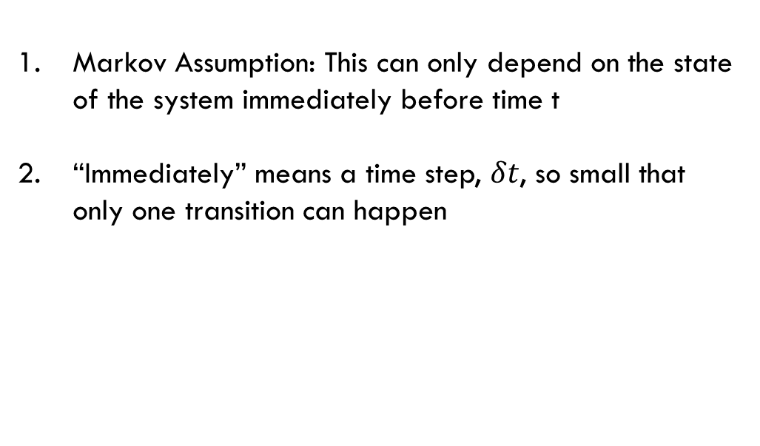
Epidemiology Cont’d
Construction:
Starting with $I_{0}=1$ at$t=0$, we want to know the probability of being in state I at time t
Markov Assumption: This can only depend on the state of the system immediately before time t
“Immediately” means a time step, $δt$, so small that only one transition can happen
$$P_{I}\left(t\right)=?$$

Slide 27
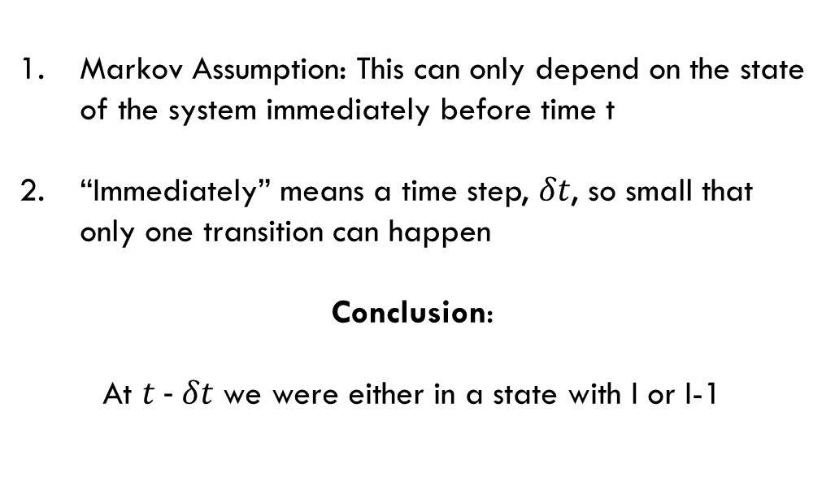
Epidemiology Cont’d
Construction:
Starting with $I_{0}=1$ at$t=0$, we want to know the probability of being in state I at time t
Markov Assumption: This can only depend on the state of the system immediately before time t
“Immediately” means a time step, $δt$, so small that only one transition can happen
Conclusion:
At $t − δt$ we were either in a state with I or I-1
$$P_{I}\left(t\right)=?$$

Slide 28
Epidemiology Cont’d
Construction:
Starting with $I_{0}=1$ at$t=0$, we want to know the probability of being in state I at time t
Markov Assumption: This can only depend on the state of the system immediately before time t
“Immediately” means a time step, $δt$, so small that only one transition can happen
Conclusion:
At $t − δt$ we were either in a state with I or I-1
$$P_{I}\left(t\right)=p_{I|I−1}\left(δt\right)P_{I−1}\left(t−δt\right) +p_{I|I}(δt)P_{I}\left(t−δt\right)$$

Slide 29
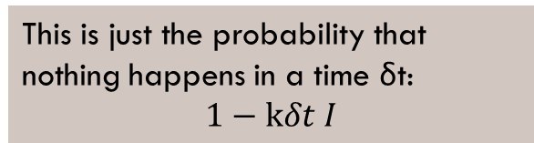
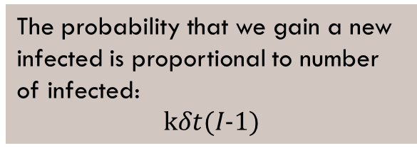
Epidemiology Cont’d
Construction:
Starting with $I_{0}=1$ at$t=0$, we want to know the probability of being in state I at time t
The probability that we gain a new infected is proportional to number of infected:
$$kδt(I−1)$$
Markov Assumption: This can only depend on the state of the system immediately before time t
“Immediately” means a time step, $δt$, so small that only one transition can happen
Conclusion:
At $t − δt$ we were either in a state with I or I-1
$$P_{I}\left(t\right)=p_{I|I−1}\left(δt\right)P_{I−1}\left(t−δt\right) +p_{I|I}(δt)P_{I}\left(t−δt\right)$$
This is just the probability that nothing happens in a time δt:
$$1−kδt I$$

Slide 30
Epidemiology Cont’d
Construction:
Starting with $I_{0}=1$ at$t=0$, we want to know the probability of being in state I at time t
The probability that we gain a new infected is proportional to number of infected:
$$kδt(I−1)$$
Markov Assumption: This can only depend on the state of the system immediately before time t
“Immediately” means a time step, $δt$, so small that only one transition can happen
Conclusion:
At $t − δt$ we were either in a state with I or I-1
$$P_{I}\left(t\right)=kδt(I−1)P_{I−1}\left(t−δt\right) +(1−kδt I)P_{I}\left(t−δt\right)$$
This is just the probability that nothing happens in a time δt:
$$1−kδt I$$

Slide 31
Epidemiology Cont’d
Construction:
Starting with $I_{0}=1$ at$t=0$, we want to know the probability of being in state I at time t
$$P_{I}\left(t\right)=kδt(I−1)P_{I−1}\left(t−δt\right) +(1−kδt I)P_{I}\left(t−δt\right)$$
Rearrange the equation
Left hand side is the definition of a derivative, take limit
Result is a “Master Equation”
$$\frac{P_{I}\left(t\right)−P_{I}(t−δt)}{δt}=k(I−1)P_{I−1}\left(t−δt\right)−kIP_{I}\left(t−δt\right)$$
$$\frac{d}{dt}P_{I}\left(t\right)=k(I−1)P_{I−1}\left(t\right)−kIP_{I}\left(t\right)$$

Slide 32
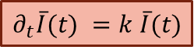
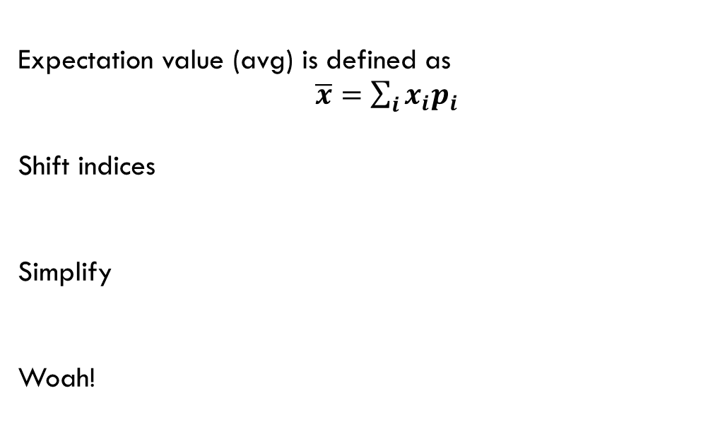
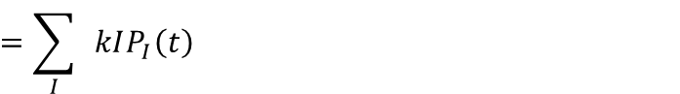
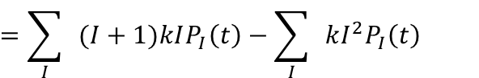
Epidemiology Cont’d
The average solution is the ODE:
We take a quick detour to demonstrate that the mean solution is equivalent to the simple epi ODE
$$\frac{d}{dt}P_{I}\left(t\right)=k(I−1)P_{I−1}\left(t\right)−kIP_{I}\left(t\right)$$
Expectation value (avg) is defined as
$\overline{x}=\sum_{i}{x_{i}p_{i}}$
Shift indices
Simplify
Woah!
$$∂_{t}\overline{I}(t)=\sum_{I}{I}\frac{d}{dt}P_{I}\left(t\right)=\sum_{I}{I}k\left(I−1\right)P_{I−1}\left(t\right)−\sum_{I}{ }kI^{2}P_{I}\left(t\right)$$
$$=\sum_{I}{ }(I+1)kIP_{I}\left(t\right)−\sum_{I}{ }kI^{2}P_{I}\left(t\right)$$
$$=\sum_{I}{ }kIP_{I}\left(t\right)$$
$$∂_{t}\overline{I}(t) =k \overline{I}(t)$$

Slide 33
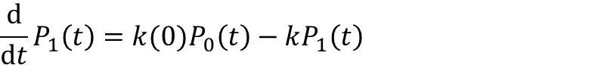
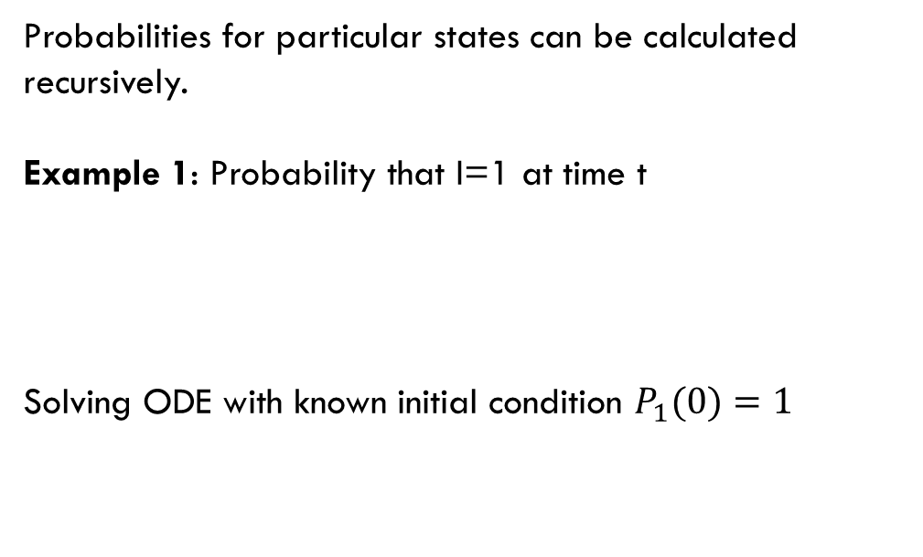
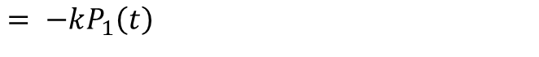
Epidemiology Cont’d
The Master Equation:
Aptly named, the Master Equation is all that’s needed to calculate any statistical quantity
$$\frac{d}{dt}P_{I}\left(t\right)=k(I−1)P_{I−1}\left(t\right)−kIP_{I}\left(t\right)$$
Probabilities for particular states can be calculated recursively.
Example 1: Probability that I=1 at time t
Solving ODE with known initial condition $P_{1}(0)=1$
$$\frac{d}{dt}P_{1}\left(t\right)=k(0)P_{0}\left(t\right)−kP_{1}\left(t\right)$$
$$= −kP_{1}\left(t\right)$$
$$P_{1}\left(t\right)=e^{−k t}$$

Slide 34
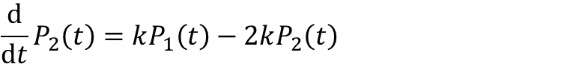
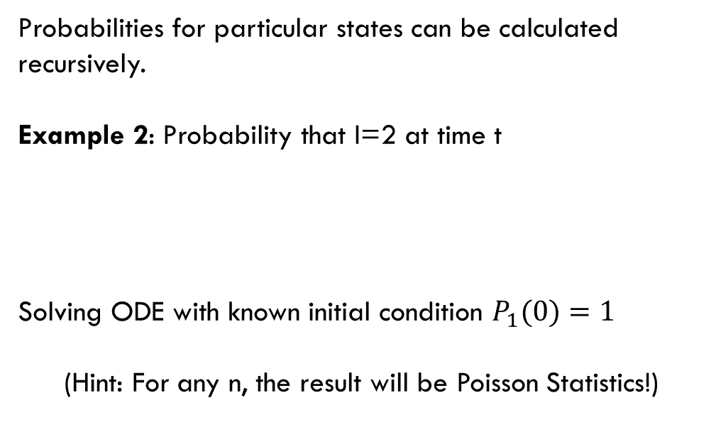
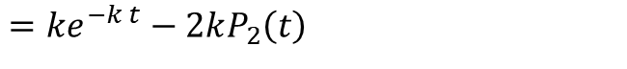
Epidemiology Cont’d
The Master Equation:
Aptly named, the Master Equation is all that’s needed to calculate any statistical quantity
$$\frac{d}{dt}P_{I}\left(t\right)=k(I−1)P_{I−1}\left(t\right)−kIP_{I}\left(t\right)$$
Probabilities for particular states can be calculated recursively.
Example 2: Probability that I=2 at time t
Solving ODE with known initial condition $P_{1}(0)=1$
(Hint: For any n, the result will be Poisson Statistics!)
$$\frac{d}{dt}P_{2}\left(t\right)=kP_{1}\left(t\right)−2kP_{2}\left(t\right)$$
$$=ke^{−k t}−2kP_{2}\left(t\right)$$
$$P_{2}\left(t\right)={kt e}^{−k t}$$

Slide 35
Epidemiology Cont’d
The Master Equation:
Most importantly, the Master Equation is an Algorithm
$$\frac{d}{dt}P_{I}\left(t\right)=k(I−1)P_{I−1}\left(t\right)−kIP_{I}\left(t\right)$$
Once you have the Master Equation, you merely have to translate it to code.
More on this in the Numerics Section
These are extremely useful tools for any simulation work.
for t in range(1,t_max):
random_number = random.random()
if random_number>(1-k*I[t-1]):
I[t]= I[t-1]+1
else:
I[t]=I[t-1]

Slide 36
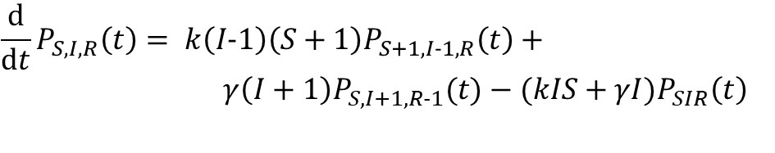
Epidemiology Cont’d
SIR Master Equation:
Be sure to derive this in the group notebook!
It looks complicated but deriving this following the simple case is an instructive and clarifying exercise.
This will be the starting point for your algorithm!
Once you understand how to derive this, developing variations will be simple
$$\frac{d}{dt}P_{S,I,R}\left(t\right)= k\left(I−1\right)\left(S+1\right)P_{S+1, I−1,R}\left(t\right)+$$
$γ\left(I+1\right)P_{S,I+1, R−1}(t)−(kIS+γI)P_{SIR}\left(t\right)$

Slide 37
Epidemiology Cont’d
SIR Master Equation:
Be sure to derive this in the group notebook!
Suggested Variations
Same as ODE version, sans the spatial dependence (this is a shockingly difficult extension)
Statistical analysis is easy, can show how variance changes with different initial conditions, extensions
Stochastic mutant growth and spread (*)
More advanced studies (potentially publication worthy) for highly motivated students with programming experience are possible
$$\frac{d}{dt}P_{S,I,R}\left(t\right)= k\left(I−1\right)\left(S+1\right)P_{S+1, I−1,R}\left(t\right)+$$
$γ\left(I+1\right)P_{S,I+1, R−1}(t)−(kIS+γI)P_{SIR}\left(t\right)$

Slide 38
Ancestry
When viruses replicate, there is some chance that an error places the incorrect nucleotide.
This creates a “mutant”
A mutant that is capable of functioning and reproducing can fix in the population

Slide 39
Ancestry
The history of these mutations at the genetic level is called a phylogeny.
It is usually represented on a tree
Here we show a time resolved tree

Slide 40
Ancestry
When the time of events isn’t clear, trees can be plotted against “divergence”, or mutations per nucleotide.
This is the most common display

Slide 41
Ancestry
Given a set of sequences, we’d like to reconstruct this tree.
Problem:
Sequences are just random strings of letters
(A, T , C, G)
How do we infer relationships?
?

Slide 42
Ancestry
Problem:
Sequences (genomes) are just random strings of letters
(A, T , C, G)
How do we infer relationships?
Idea 1:
Define a notion of “distance” between two genomes based on the number of differences between then
?

Slide 43
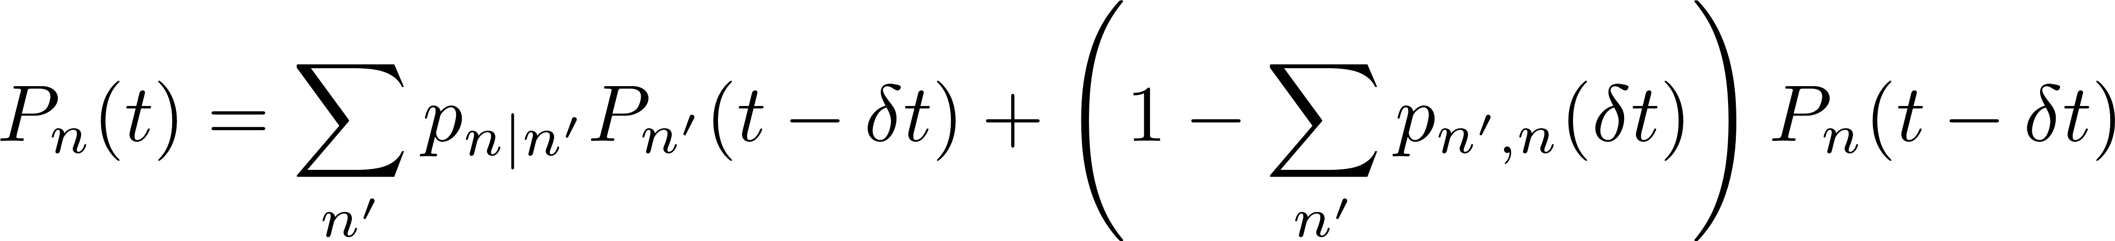
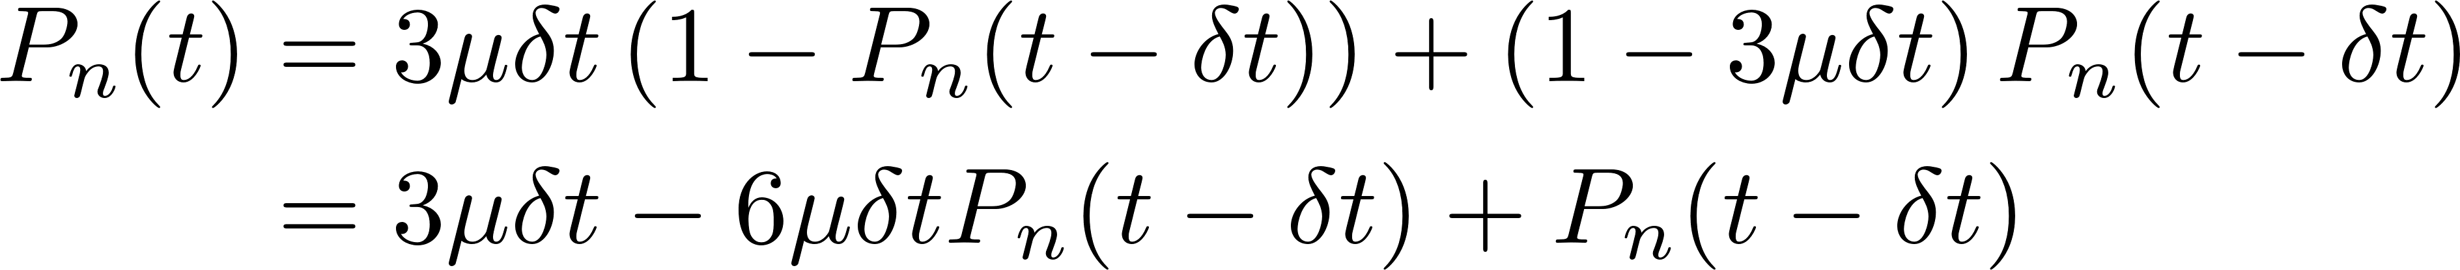
Ancestry
The Jukes-Cantor Model:
Assume that the nucleotide mistakes are a markov process

Slide 44
